Slide 1
Your broken resume
And how to fix it

Slide 2
The fixes (and mistakes)
What does your audience want? (don’t focus on you!)
Sell yourself above the fold (don’t waste valuable resume real estate!)
Highlight results, accomplishments with dollars, numbers and percentages (don’t speak only about responsibilities!)
Scrub for errors and inconsistencies (no typos, oddities or falsehoods!)
Avoid old-school resume habits (references available, position of education, +)

Slide 3
1.1 what your audience wants
THE PROBLEM:
It’s all about me
Uses I, me, my language
Focuses on what I want
Has an “Objective statement”
Lacks clear results
Full disclosure vs. good sales message

Slide 4
1.2 what your audience wants
THE FIX:
WIIFM – What’s in it for me?
By “me” I mean “them”
Answer the question: What problem does this person solve for ME?
Avoid first person: I, me, my, we
Lead with a good professional summary (speaks to them) instead of an objective (says what I want)
Remember this is a sales document!

Slide 5
2.1 Sell yourself above the fold
THE PROBLEM:
Fold your resume like a newspaper at the 5 ½” mark
Waste valuable real estate on your resume
Add unnecessary information that pushes your good information lower in the document
Fail to make it easy to read, especially early on
What do you think is the average attention span of a normal adult?
Some brain science stats:

Slide 6
2.2 Sell yourself above the fold
BRAIN SCIENCE:
In 2000, average attention span: 12 seconds

Slide 7
2.3 Sell yourself above the fold
BRAIN SCIENCE:
In 2013, average attention span: 8 seconds

Slide 8
2.4 Sell yourself above the fold
BRAIN SCIENCE ASIDE:
average attention span of a goldfish: 9 seconds

Slide 9
2.5 Sell yourself above the fold
BRAIN SCIENCE:
average number of times per hour an office worker checks email inbox: 30

Slide 10
2.6 Sell yourself above the fold
BRAIN SCIENCE:
Percent of words read on an average webpage of 593 words: 28% or 166 words

Slide 11
2.7 Sell yourself above the fold
BRAIN SCIENCE:
Percent of words read on a webpage with 111 words or less: 49% or 54-ish
Brain science research from statisticbrain.com; Harald Weinreich, Hartmut Obendorf, Eelco Herder, and Matthias Mayer: “Not Quite the Average: An Emperical Study On Web Use”, in the ACM Transaction on the Web, vol. 2, no. 1 (February, 2008), article #5

Slide 12
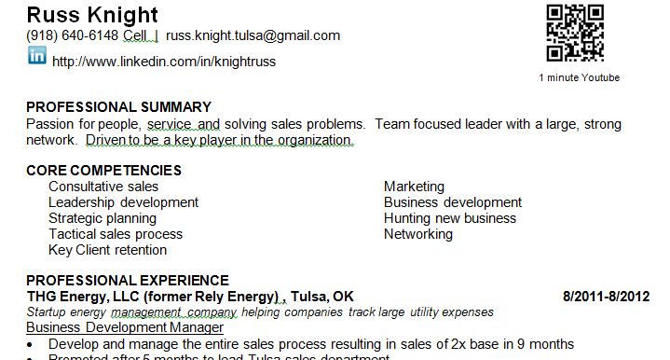
2.8 Sell yourself above the fold
THE FIX / WHAT DOES THIS MEAN TO YOU?
Get to the point
Be brief
No physical address
Exactly 25 words

Slide 13
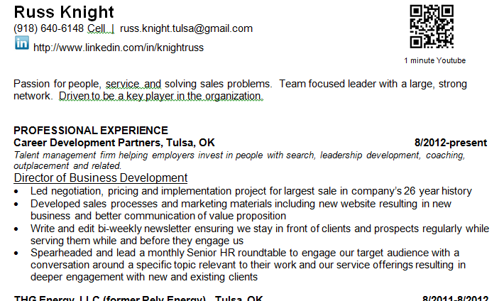
2.9 Sell yourself above the fold
THE FIX / WHAT DOES THIS MEAN TO YOU?
Get to the point
Be brief
If I was recreating this today, it would look more like this:
No “professional summary headline”
No “Core Competencies”

Slide 14
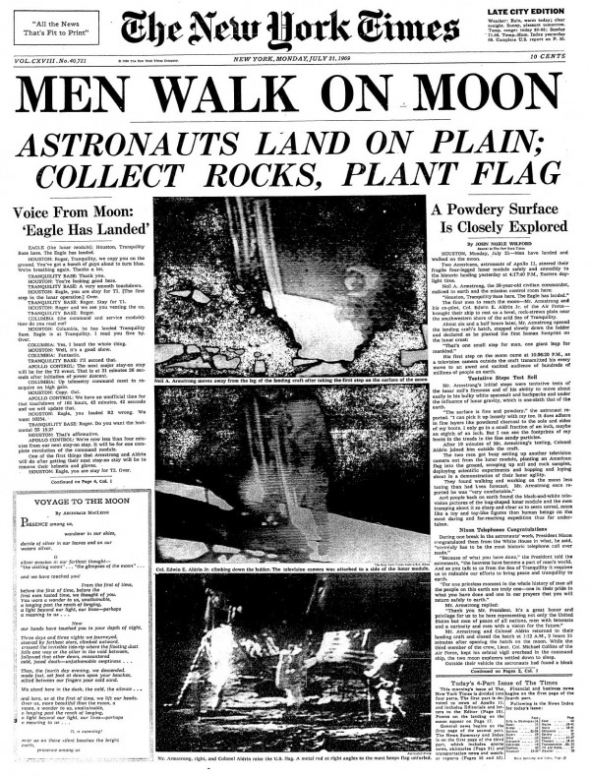
2.10 sell yourself above the fold
KEY: If you don’t catch their interest ABOVE the fold, they won’t read below it.

Slide 15
3.1 Highlight results with $, # & %
THE PROBLEM:
Resume reads like a job description
Responsible for sales
Manage the Revenue, JIB, Asset Management, Treasury, and Special Projects functions with a staff of 17 individuals (three supervisors, three seniors, 11 staff)
Incomplete equations; you only include one side (responsibilities) vs. what you did when employer trusted you with those responsibilities

Slide 16
3.2 Highlight results with $, # & %
THE FIX:
If it’s worth saying on a resume, it’s worth including a result
What if I don’t have access to actual numbers or my work is difficult to quantify?
Ask a former supervisor
Quote performance reviews
Calculate and estimate, aim low; if you figure you saved 25% based on just your calc., say 20% on resume; be ready to explain

Slide 17
3.3 Highlight results with $, # & %
EXAMPLES:
Recruit for intern, entry level and administrative positions including sourcing and screening candidates, facilitating the interview process and directing the offer process including making compensation recommendations. Result: Completed recruiting process for more than 20 employees.
In first 3 months, identified and sold an additional service that increased company’s gross revenue by 1.3% or $360,000, which was a high-margin additional use of existing service

Slide 18
3.4 Highlight results with $, # & %
MORE EXAMPLES:
Direct and promote wellness initiatives including voluntary team and individual challenges. Result: Achieved 30-35% participation.
Negotiated a worldwide five-year software renewal contract with company's largest global client resulting in a $2.5 million sale and a long-term contractual commitment for database purchases.
Increased output, $26M in 2011 to $37.5M in 2013. OTD, 82.3% to 92.66%. Past due, $1.72M to $160K.
Reduced scrap costs by $800k.

Slide 19
4.1 scrub for errors and inconsistencies
THE PROBLEM:
Minor typos
Major grammatical errors
Incorrect verb tense; lead vs. led
Inconsistent match between resume and LinkedIn profile, esp. dates of employment
Over-stating results
Complete lies – jobs that you never had
Education / degree not complete
Missing or incorrect contact information
Bullet inconsistency
Font inconsistency

Slide 20
4.2 Irregularities

Slide 21
4.3 scrub for errors
SURVEY DATA:
In 2009, Accountemps surveyed 150 senior executives from F1000 companies
Question: “How many resume typos does it take to decide not to consider a job candidate?”
One: 40%
Two: 36% 76% will toss you for just one or two!
Three 14%
Four+: 7%
How many are you willing to risk?

Slide 22
4.4 scrub for errors
COMMON MISTAKES:
Their / there
To / too
Some / sum
MS Excel / excel (the verb)
Spell check won’t catch these!

Slide 23
4.4 scrub for errors and inconsistencies
THE FIX
Use spellcheck, but only as a first line of defense
Proofread it
Proofread it again the next day
Proofread by reading each word backwards / bottom up
Ask a meticulous friend/ family member to proof read it
Pay special attention to software names, acronyms, company names, school names, etc.
If your resume is sloppy, maybe your work is too!

Slide 24
5.1 Avoid old-school habits
THE PROBLEM:
Physical address
Objective
References available upon request
Written in 3rd person (as though someone else is speaking about you)
Resume saved as “resume1” or “resume-final”
Unprofessional sounding email
One page resume (for anyone other than a new grad)
Include personal information – married, kids, etc.

Slide 25
5.2 Avoid old-school habits
THE FIX:
Limited address – Tulsa, OK 74135
Employers don’t need to contact you via your mailing address as part of the job search process
An employer could use your address using zillow.com to determine how much your home is worth to potentially low-ball an offer, especially if you have been on the hunt for a while

Slide 26
5.3 Avoid old-school habits
THE FIX:
Professional summary vs. objective
Objectives are taught to new grads
They have no work history that defines their career
Objectives are about YOU, not them

Slide 27
5.4 Avoid old-school habits
THE FIX:
References are assumed; no need to mention
You may want to include “references available upon request” because that’s what’s been taught forever.
If you don’t have references, you’re dead before you start.

Slide 28
5.5 Avoid old-school habits
THE FIX:
Save your file as though it will be saved by someone with more than a few resumes
First_Last_1014
Last_First_Oct14
Last_First_Company_Oct14
Last_First_Company_Title_102314
Use any “separator” you like - _
My preference is not to use spaces in naming any document

Slide 29
5.6 Avoid old-school habits
THE FIX:
3rd person: Jane Doe is an excellent event manager and never went over budget
Better: Managed numerous events ranging from $40,000 - $1.2MM, always staying within budget
It can be tough to scrub out the 3rd person
You may need to step away and try at another time

Slide 30
5.7 Avoid old-school habits
THE FIX:
Unprofessional sounding emails don’t give a good first impression!
EXAMPLES:
Couchpotato64@junkmail.net
Beachbum08@unprofessional.com
TIPS:
Use something as close to first initial + last name or first + last or first.last
If you use a number make it one digit or three; avoid two or four (they look like dates of birth, graduation, etc.)

Slide 31
5.8 Avoid old-school habits
THE FIX:
As a rule, your resume needs to be two pages
One page resumes are mostly just for new grads
Exceptions abound with resume rules
Technical resumes likely are longer
Senior executives are likely longer
If it goes longer than two pages, make it interesting!

Slide 32
5.8 Avoid old-school habits
THE FIX:
Omit personal information
Marital status
Divorce
Children
Ill or aging parents
Cut this from both your resume and any job-related communication

Slide 33
MY CHALLENGE
You have been coming to OJTTulsa for a few weeks or months
What are you APPLYING?
What are you doing DIFFERENTLY based on what you have learned?
We don’t ask you for anything as a result of this but I am now:
respond to this – email me your resume at OJTjobs@gmail.com
Press as hard as you can – increase your job search activity

Slide 34
thanksgiving
We have 33 days until Thanksgiving (11/27/14)
Don’t believe the rumor that says hiring slows between Thanksgiving and New Years!!!
You are only looking for ONE JOB
Individual jobs get filled every day
Don’t back off during the holidays because you heard about a slow down in hiring!
Even if it happens, the people that get hired in January are the ones who press in November and December!

Slide 35
finally
Resume advice is cheap – most people are willing to offer it, even when it’s contrary to the last respected professional!
Consider more advice than you apply, including mine!
The goal of the resume is interviews, calls, inquiries, interest in you and your skill set right?
If your current resume is getting you RESULTS, you can set aside all the other advice you get.

