Slide 1
Humble Inquiry: An Invitation to a Conversational Dance
Asking without telling, listening
on several levels,
asking again and learning

Slide 2
Many Talented People Have These Uncertainties:
I do not understand my purpose.
I am not sure how I fit in.
I do not know who to trust.
I am deathly afraid of failure.
I do not have time to think about my future.
I do not know what drives me.
I am unclear about what is expected of me.
Humble Inquiry resolves most of these issues.

Slide 3
Ancient Wisdom
“The unexamined life is not worth living.” ……. Socrates, 470-399 B.C.
“The man who looks outside dreams;
The man who looks inside awakens.”
….. Goerthe, 1749-1832 A.D.

Slide 4
What is Leadership?
The Ability
To Take People to a Better Place
with the
Attitude of a Humble Servant and
the Curiosity of a Mindful Beginner

Slide 5
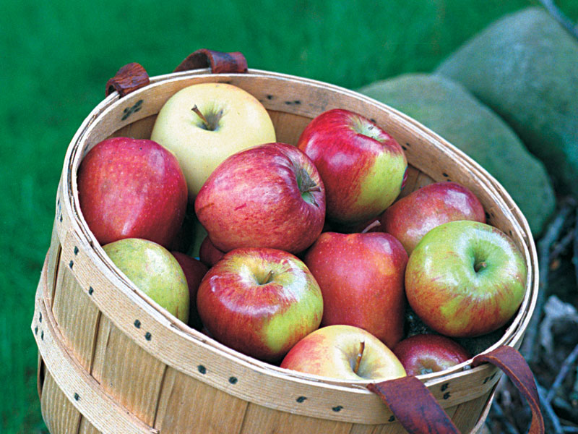
What People Want from their Leaders:
TRUST
STABILITY
COMPASSION
HOPE
“A place to stand, people to stand with, and something to stand for.”
HOW ABOUT
THEM APPLES?

Slide 6
Core Career Values The Building Blocks
What is Important to You About
Having a Career?
What are Your Non-Negotiable Core Values?
One Example: Technical Excellence | Truth |
Innovation | Recognition | Personal Integrity
What is it for YOU?

Slide 7
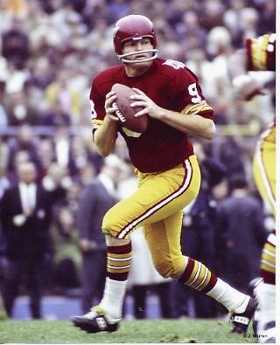
Keeping Your Eyes Downfield
The Receiver
Goes Deep, The Quarterback
Goes Long, and the Football Converges with the Future.

Slide 8
Re-perceive: To Perceive Again Usually in a Different Way
GO DEEP
Gain Insight
Explore Your “Inner World”

Slide 9
Through Insight You Dig Deep with These Questions
What are Your Core Values?
What are Your Long-Term Goals?
What are Your Strengths?
What Drives You?
How do You Fit In?
Who Cares?

Slide 10
What Are Your Choices?
GO LONG
Gain Foresight
Re-perceive the Future

Slide 11
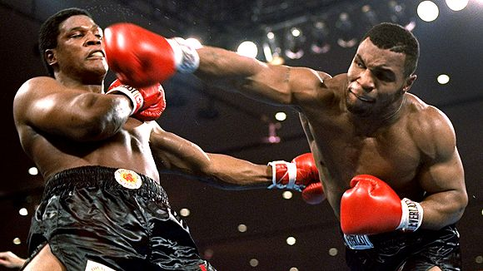
“Everybody has a Plan Until I Hit ‘Em”.
… Mike Tyson
All of us have been hit. But it isn’t what they do that counts, it’s what we do about what they do that matters.

Slide 12
Create Alternative Scenarios of Your Future
PLAN B
PLAN C
PLAN D
PLAN A
2020
CREATIVE TENSION
TODAY
CURRENT MODEL

Slide 13
Who Cares?
Build Relationships
Gain Access
Who do You Know?
Who Knows You?

Slide 14
This is what I do; it is all that I do.
Frank Wantland, PhD
918-813-0096
frankwantland@gmail.com
LinkedIn: frankwantlandphd
I have been doing this for forty years;
I have seen and heard a thing or two.

