Slide 1
GETTING THE MOST OUT OF THE PROGRAM
&
BEST PRACTICES
Notes:
OJT FIRST MEETING WITH BILL JOHNSON AND LEONARD REITZ

Slide 2
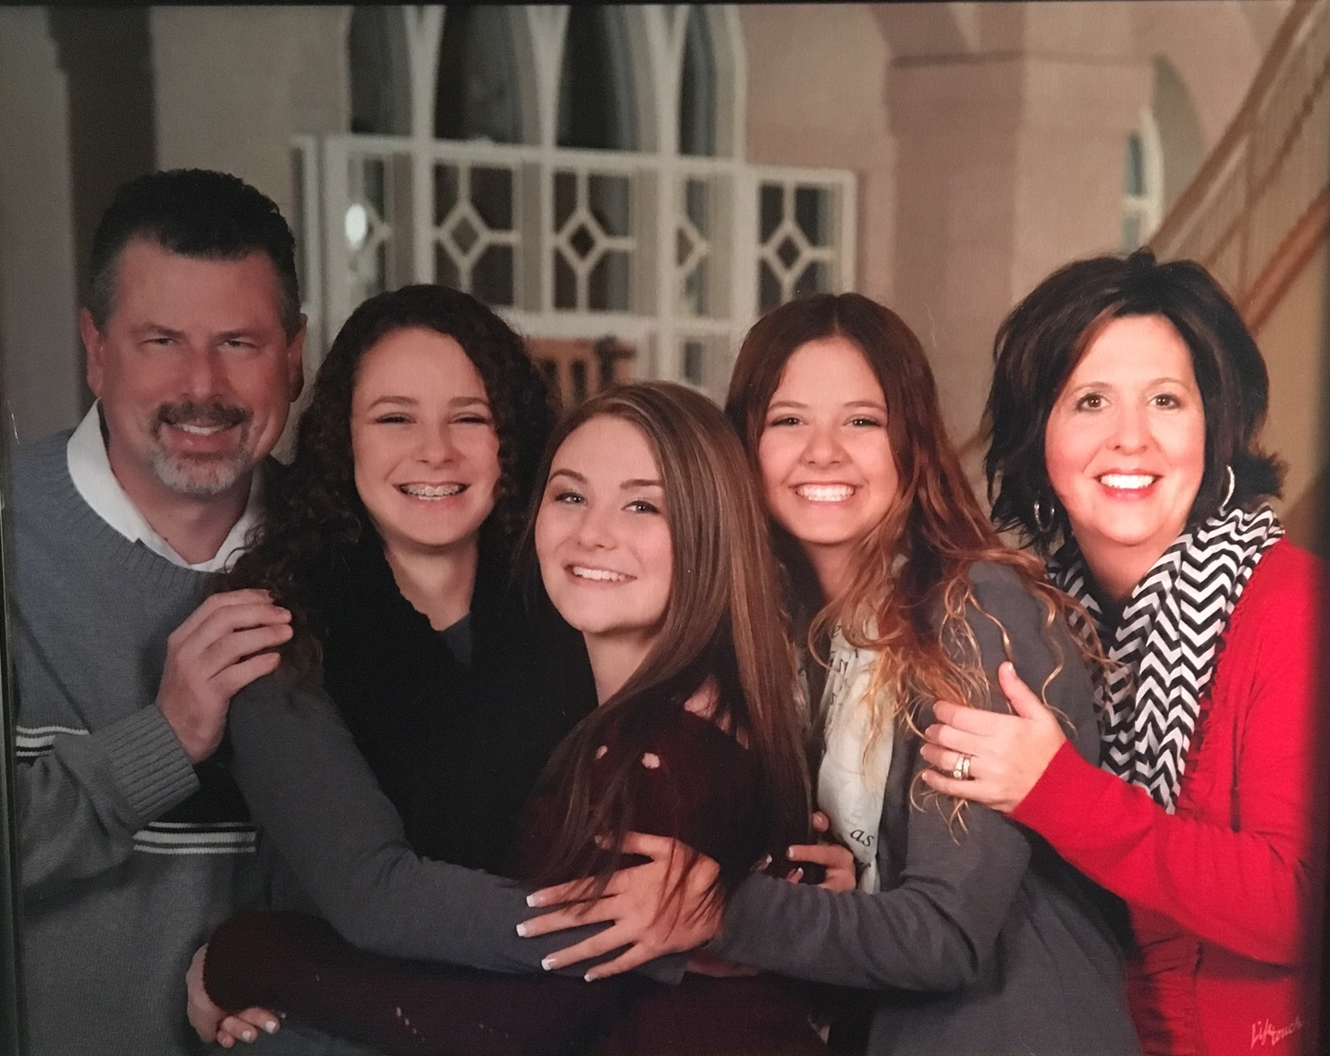
Notes:
FAMILY BACK GROUND, FAMILY AND GROWING UP IN OWASSO- CYCLE GANG

Slide 4
Why are you here?
Get the best job, for the most money, in the shortest time possible

Slide 5
Is your LinkedIn Profile Complete?
If not you are missing out on 50% of the searches by recruiters

Slide 6
Importance of completing your profile
LinkedIn says that members who have a complete profile are 40 times more likely to receive opportunities. Get to ALL STAR level status.
How: COMPLETE YOUR PROFILE!
TOC

Slide 8
How Successful People Stay Calm Top performers have well-honed coping strategies
They Appreciate What They Have
They Avoid Asking “What If?”
They Stay Positive
They Squash Negative Self-Talk
They Reframe Their Perspective
- Travis Bradberry, Ph.D.
Emotional Intelligence 2.0
Notes:
OU vs OSU MOWING STORY

Slide 9
Who is the greatest self-promotor of all time?

Slide 12
Critical Steps FOR Success
Schedule an appointment with a leader one-on-one
Go on launch pad at least once in first 30 days
Get a LinkedIn profile up and complete with all elements
Attend consistently to Weekly Thurs. meetings
Revise resume several times based on feedback
Network consistently at events so you are known
Attend all four workshop break out sessions

Slide 13
We all need to F-o-c-u-s
Follow
One
Course
Until
Success

Slide 15
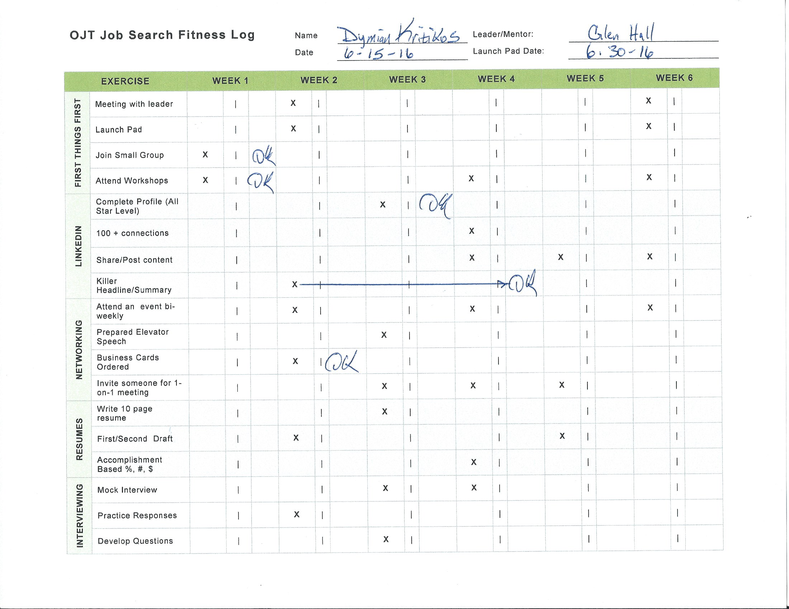

Slide 16
Networking 70% jobs found by this method
An important concept to consider is: it isn’t how many people you know but how many people know you and remember you
Notes:
Peers in this room are a great support network. Raise hands, who is willing to help someone else in this room? All look and realize we can help each other.

Slide 17
Give us feedback
Notes:
Let us know when & where you get a job. It's very rewarding for us as leaders, it's fuel for our soul, motivates us and your peers. Don't just get a job and disappear.
If you have ideas on how we can better help you please let us know. We want to continually improve.

Slide 18
Final Thoughts
We all come from such different beginnings, yet we find ourselves, here, with so much in common. Reach out to your peers, they need you.
Notes:
OPA! OPA! OPA!

