Slide 1

Leveraging LinkedIn for Career Success in 2016
Kari Mirabal
The Connection Coach
Leading you to People, Opportunity and Profit

Slide 2
3 Step
Networking Strategy

Slide 3


Slide 4
Plan

Slide 5
Who do you want to meet?
What’s your intention?
What’s your best possible outcome

Slide 6


Slide 7
Connect

Slide 8
Ways to connect on LinkedIn

Slide 9
Idea 1

Slide 10
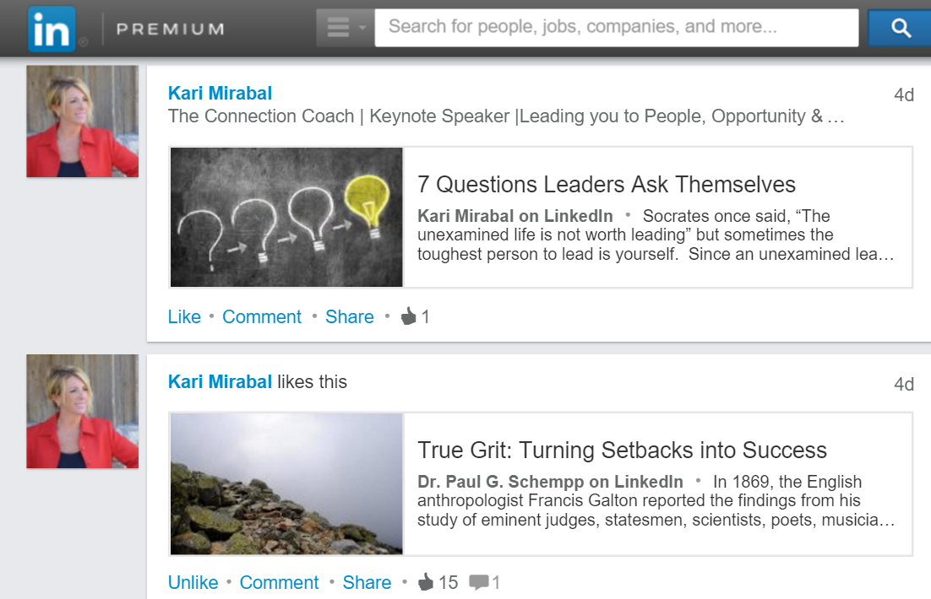
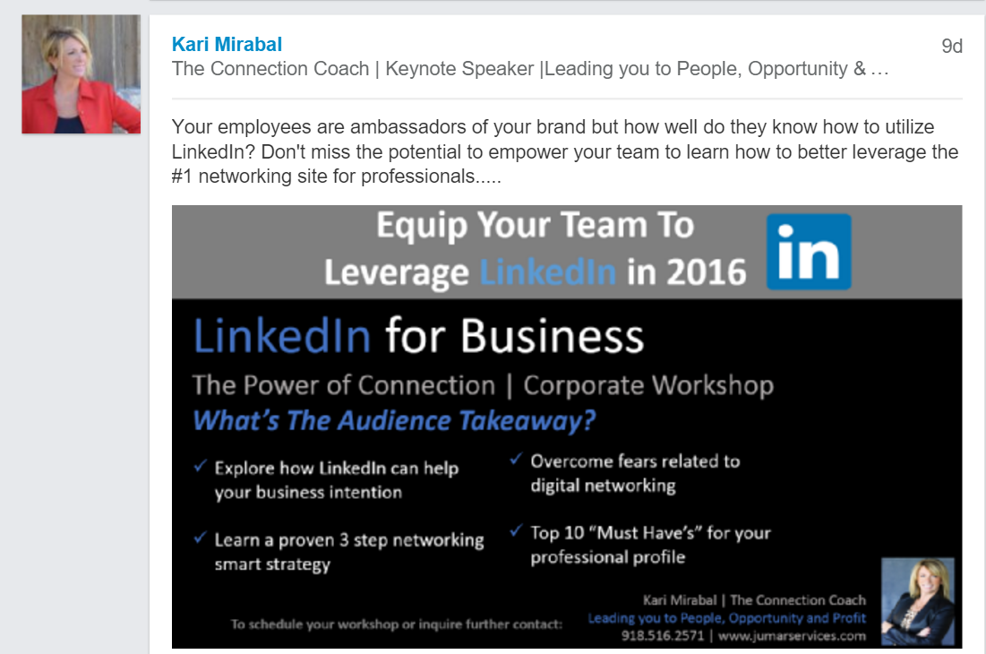

Slide 11
Idea 2

Slide 12
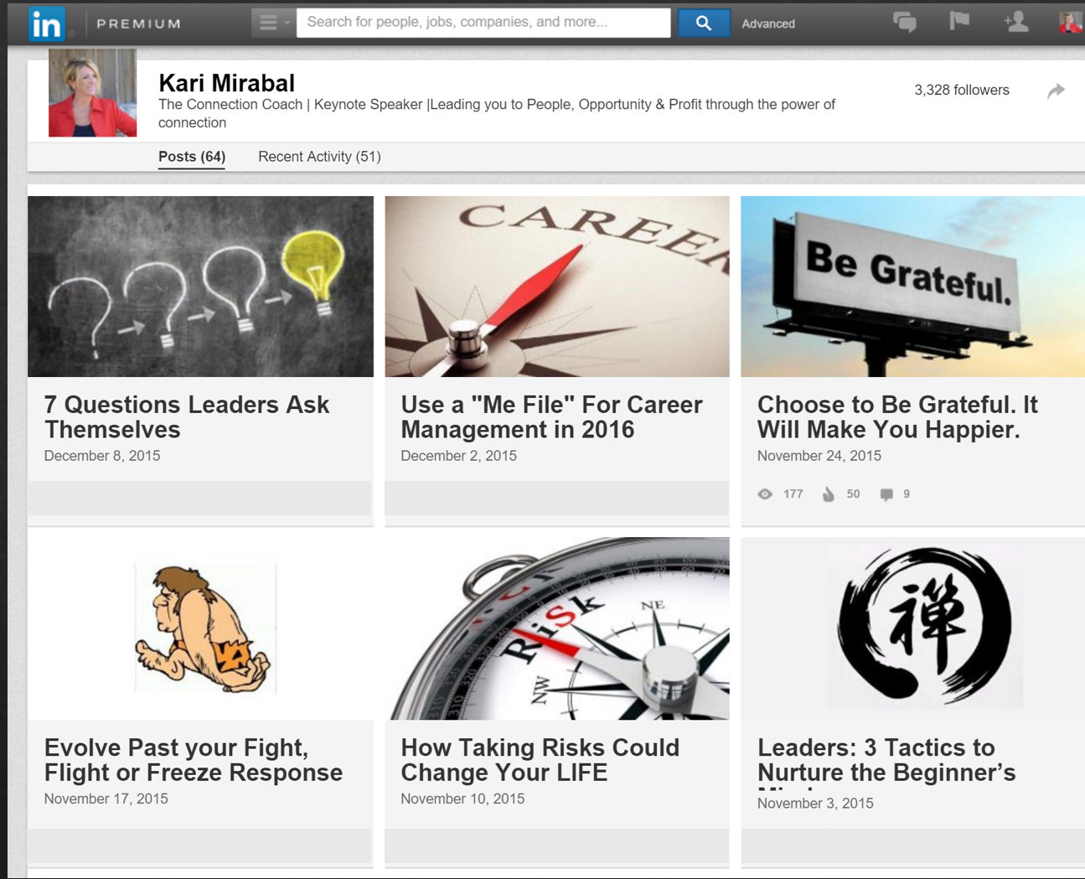

Slide 13
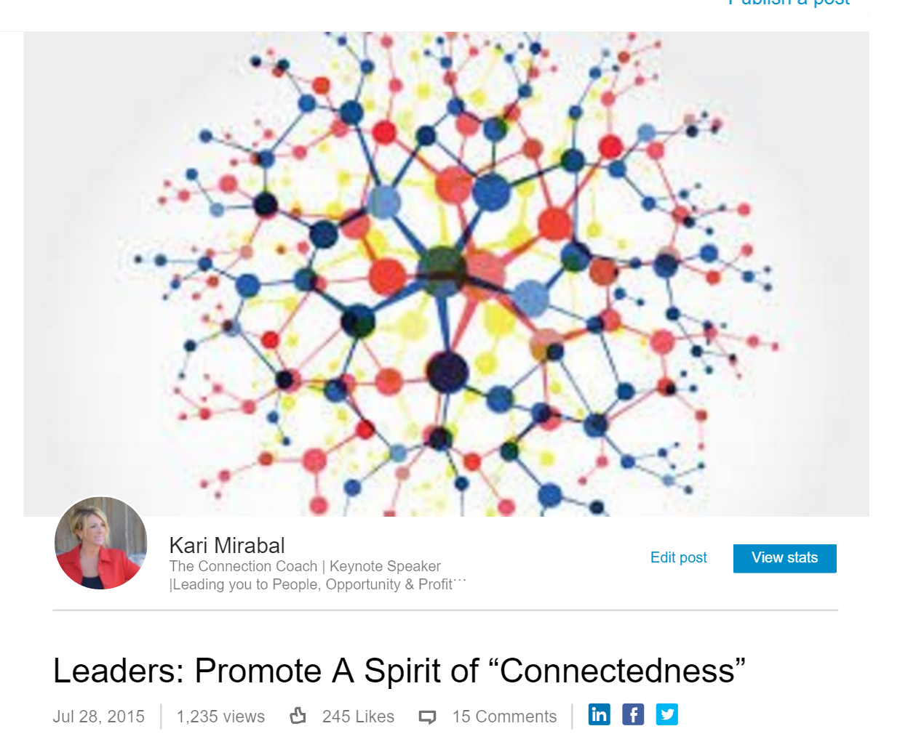

Slide 14
Idea 3

Slide 15
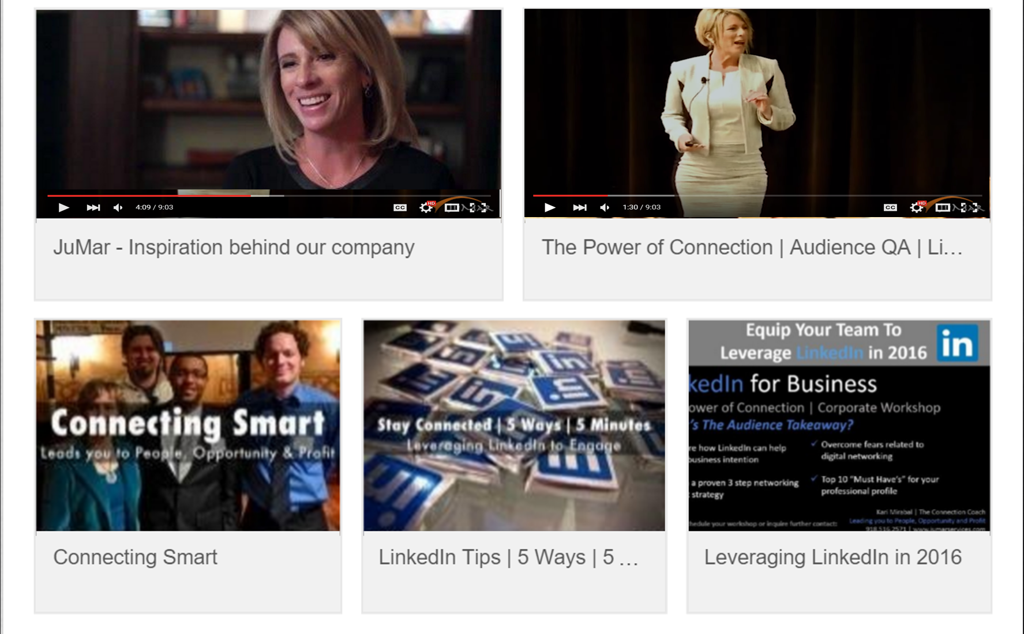

Slide 16
Idea 4

Slide 17
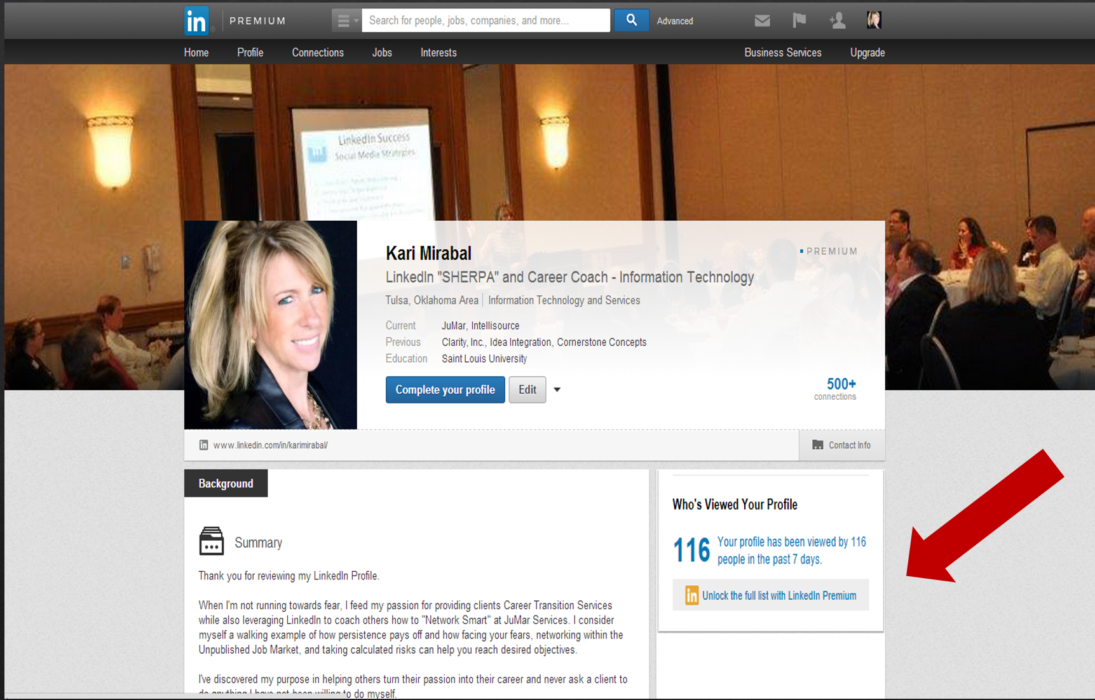

Slide 18
Idea 5

Slide 19

LinkedIn Job Search

Slide 20


Slide 21
Grow

Slide 22

LinkedIn Connected

Slide 23


Slide 24
#1
Professional Photo

Slide 25
#2
Background Photo

Slide 26
#3
Engaging Headline

Slide 27
#4
Contact Information

Slide 28
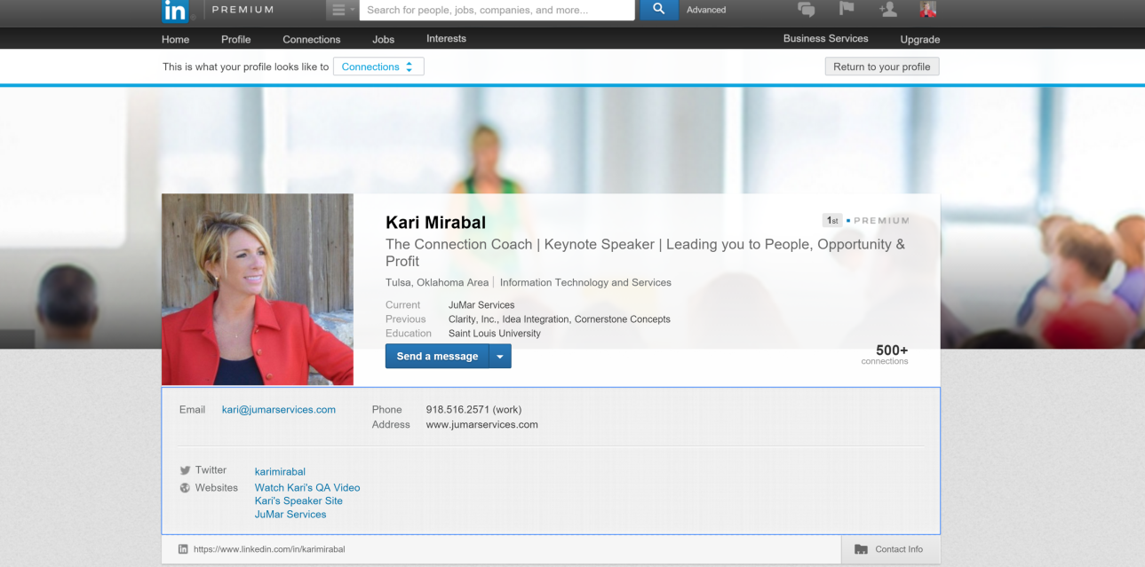
Customize Here

Slide 29
#5
Customized URL

Slide 30
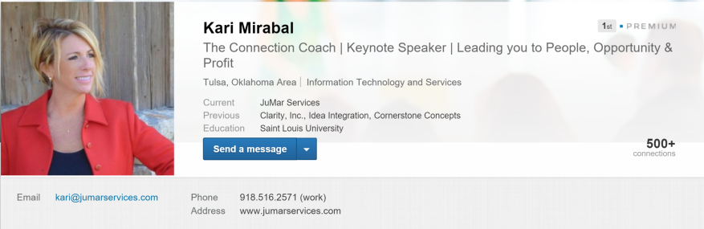
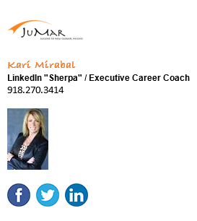

Slide 31
#6
Inviting Summary

Slide 32
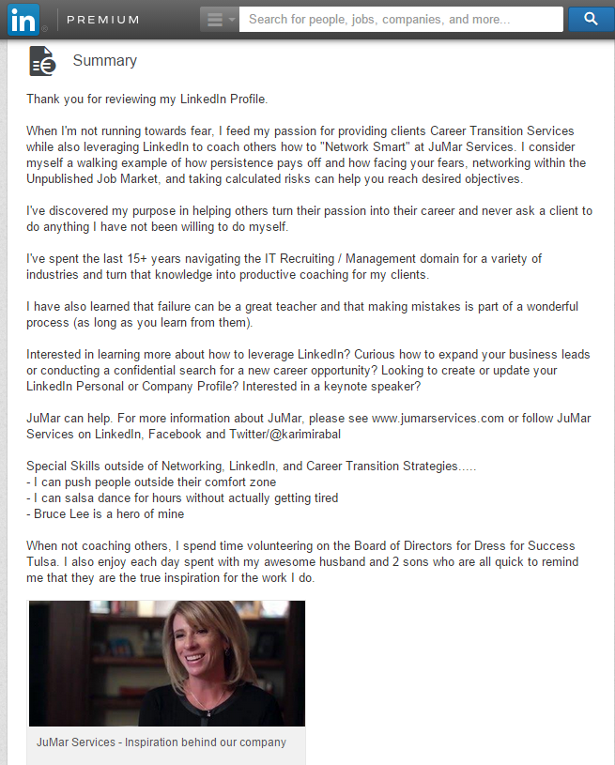
Thomas

Slide 33
#7
Professional Recommendations (3)

Slide 34
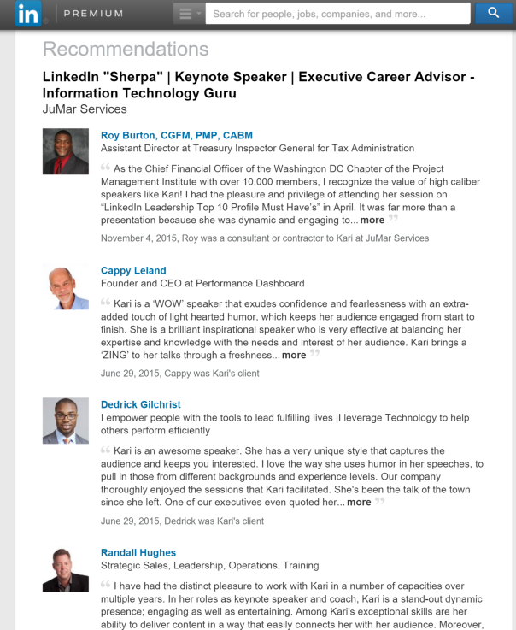

Slide 35
#8
Detailed Job Experience

Slide 36
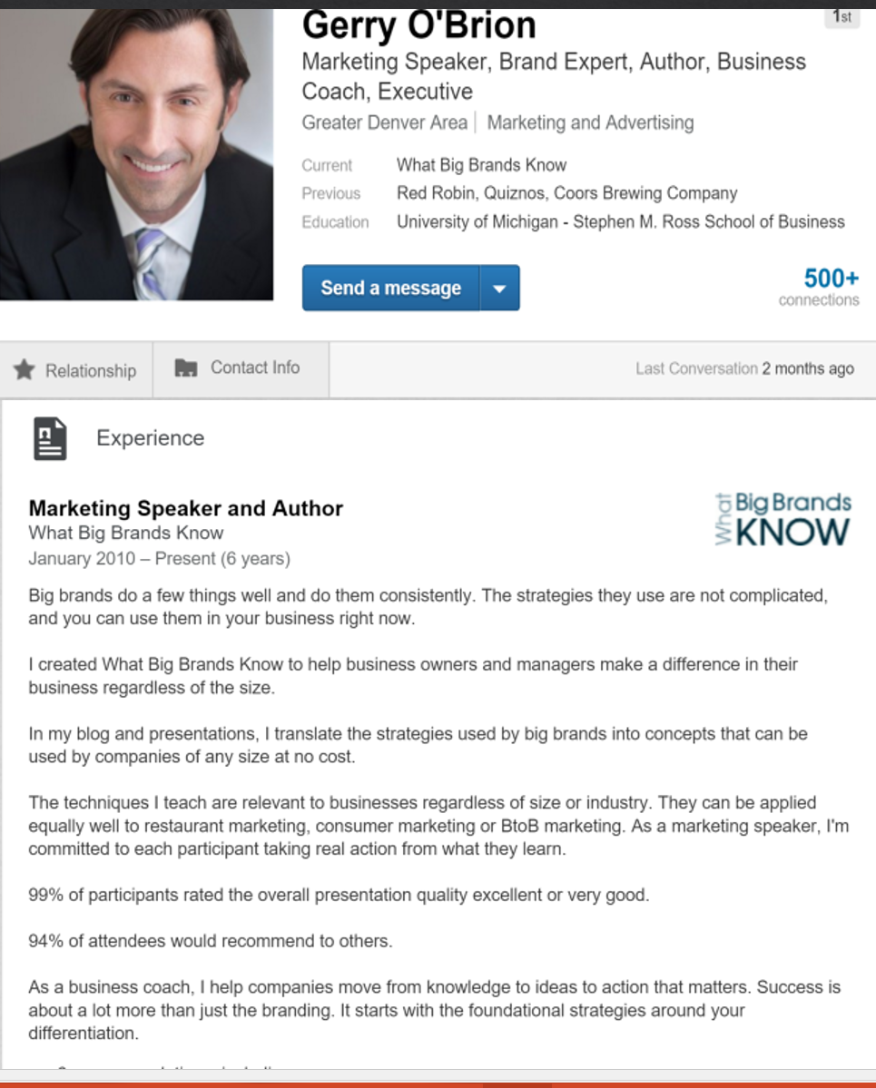

Slide 37
#9
Interests

Slide 38
#10
Best Contact Channel

Slide 39
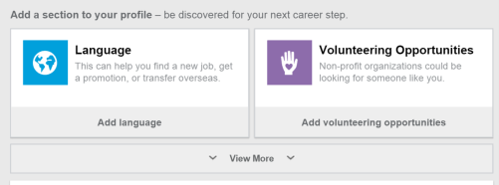
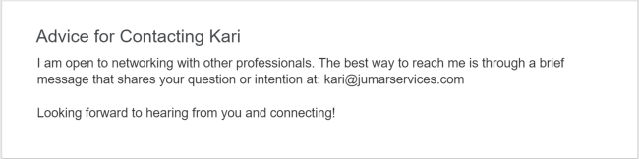

Slide 40




Let’s Stay Connected
LinkedIn:
www.linkedin.com/in/karimirabal
Email:
kari@jumarservices.com
Twitter:
@kmirabal
Website:
www.jumarservices.com

