Slide 1
Fear Factor
Cory minter

Slide 3
90% of the things we fear are considered to be insignificant issues
60% of things feared will never take place

Slide 4
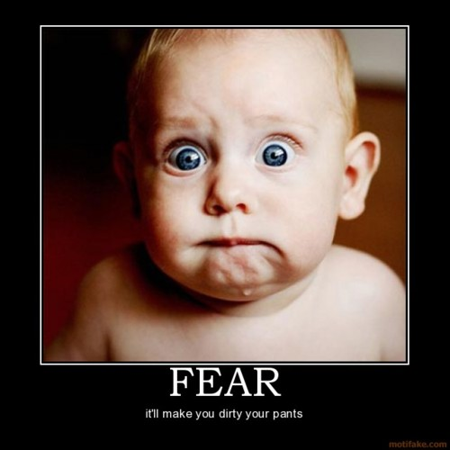
Fear is not always a bad thing

Slide 6
Fear does not show up in areas of your life that do not matter

Slide 8
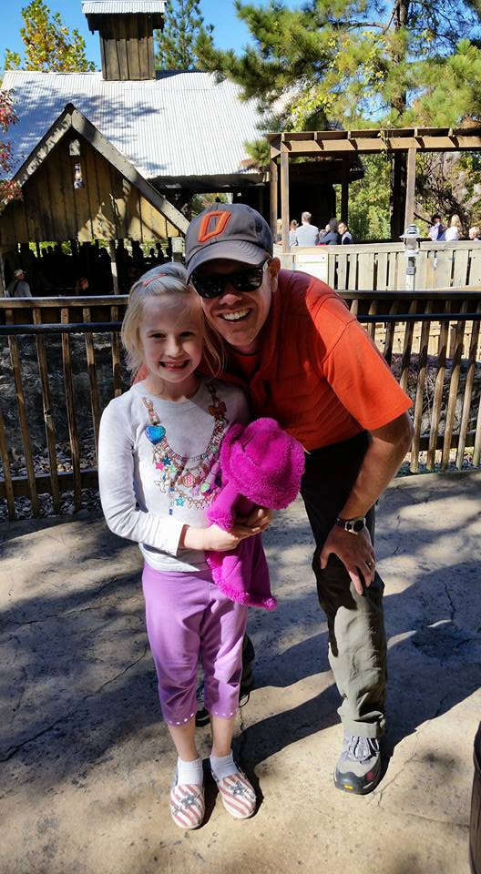

Slide 9
You have to learn to manage your imagination, or it will manage you

Slide 10
Fear can strip you of:
Confidence
Self Worth
Potential
Strength
Growth…….On and On

Slide 11
And replace it with:
Insecurity
Doubt
Confusion
Weakness

Slide 12
People react to fear in 3 different ways:
Use it as fuel…… as a motivator
Fuel it with their negative thoughts
Allow it to paralyze them

Slide 13
You better also learn to manage your perspective, or it will manage you.

Slide 14
The Voice…

