Slide 1

Advanced Boolean Job Search
& resume basics
Below I have combined decades of personal hiring experience as the hiring
decision maker and recipient of resumes/applications with the last nine
years of helping others find employment. So many concentrate on their
resume so we’ll start with that.
Be patient, learning this will take most 30 minutes to an hour of practice.

Slide 2
Resume
Only use bold for job titles, degrees, certificates and your name in the heading. Use fonts easy to read size 11 or 12, name can be a 14. No italics anywhere. If you choose an objective or opening statement keep it to three physical lines no more no less. Organization of your resume is your value strength to the employer, if its education start with it otherwise start with prior employment.
Never use lines margin to margin. You can underline a word or phrase but not margin to margin. Utilize Google’s reader upload your resume and allow it to read it back to you and evaluate how it sounds out loud. Utilize plenty of white space making it easy to read. Link to Google translator, https://translate.google.com/
First word of each bullet or sentence is important, make it a strong action word. My rule is all words 4 letters or less, can they be removed, try using a comma other than and. All 5 letter words or more do a thesaurus is there a better stronger word with the same meaning.
Never ever use a MS word template to make your resume, it must be hand typed from a blank document. Search 12 jobs using the titles you are looking for a view key terms/words within the job description. Now look at your resume, do you also use the same verbiage/words. If not inject them into your resume as they should apply.

Slide 3
Use physical numbers like (12) throughout your resume. These are eye catching to the reader. Do not worry about the actual number size like $1M as small numbers such as #1 can be just as strong. When you don’t have an exact number use your best ethical guess. Use caution making all numbers end in 00’s or the use if the + sign for the verbiage over. General rule use the last 10-12 years of work experience in your resume unless there is something older and dynamic that leads to the job you are seeking.
Resume help ideas, go to Indeed.com and click the resume tab at the top. Type in the same job skills/titles you are searching for and view others resumes. You will see many poor ones, keep looking you will see some great ones that may help you with ideas.
The biggest challenge I see over and over is, you know in your head what you want to say yet the actual words to not convey that message. Read your words do they deliver the message?
These basics above do the following; work well with ATS systems, looks great printed, easy to read, emphasis on important information, better verbiage and makes your resume stand out compared to others.

Slide 4
Job Searching
First off, networking is a key component for anyone and should be done. That said reality is most will use a computer to job search. I’m not saying don’t use Indeed.com or other job boards but I am saying you are missing many jobs doing so. Today, general job boards remain somewhat effective for those seeking hourly manual labor jobs in larger companies.
The most effective way to job search is the use of Boolean searching using a google search bar. This will require some practice on your part to master what you are seeking as everyone is different, I will explain below how to do this. Within 30 minutes of practice you will have it mastered if you stick to it making your search much more effective. First, the Boolean terms we will be using and how they are used.

Slide 5
Boolean search operators list
Boolean operator | Use | Example
AND | Results include all keywords linked with AND | ‘developer AND android’
OR | Results include either keyword or all of them | ‘android OR mobile’
symbol(-) | Excludes a keyword from your search (When using the minus symbol don’t leave a space before the unwanted term) | -sample
Brackets () | Group multiple search strings and set priorities | ‘Project (manager OR coordinator)’
Quotation marks ” “ | Search for an exact phrase (keywords in quotation marks as a whole word) | “customer service”

Slide 6
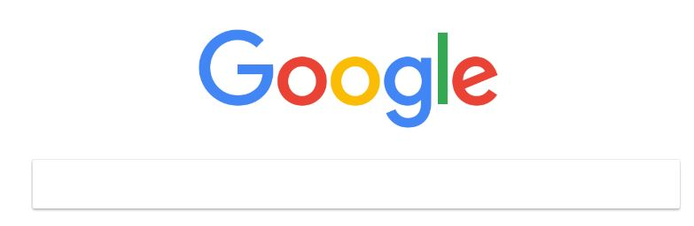
You will be using a normal search bar to type into

Slide 7
Boolean Search pg. 1
For this example, we will be looking for a Store Manager position. You would simply change Store Manager to the job title(s) you are searching. The order you input your information makes no difference.
I want to tell it I’m looking for a job. Unaware what some sites would call jobs, we will use multiple words surrounding job field so I would type:
Job jobs career careers employment
Job boards will dominate your search, so I want to eliminate these using the – sign so now my search looks like:
Job jobs career careers employment -indeed -monster -CareerBuilder
You will probably have to add more job boards so they do not overrun your results. Remember you can search job boards individually by each one later if you choose.
I want it to know I’m searching for a Store Manager. Since this is a two-word title I have to use “quotation marks” for it otherwise Google would search each word independently. One-word job titles does not require quotations. Now my search is looking like this:
Job jobs career careers employment -indeed -monster -CareerBuilder “store manager”

Slide 8
Boolean Search pg. 2
Google needs to know where to look so I will add in a city or you can add cities like below:
Job jobs career careers employment -indeed -monster -CareerBuilder “store manager” Tulsa Broken Arrow Owasso
Capitalizations make no difference
Two job titles could be done using the and. If you were searching between Store Manager and Assistant Manager, you would add it like this:
Job jobs career careers employment -indeed -monster -CareerBuilder “store manager” AND “Assistant Manager” Tulsa broken arrow Owasso
Similar applies if you are seeking either or using the or like this:
Job jobs career careers employment -indeed -monster -CareerBuilder “store manager” OR “Assistant Manager” Tulsa “broken arrow” Owasso

Slide 9
Boolean Search pg. 3
Should the job title you want have multiple choices like in the example of Project Manager or Coordinator you would use brackets like this: Project (manager OR coordinator)
As you type out your examples copy and save then to a simple document, it will make coming back to them easier, faster for later or to make edits. The above examples are minimal as you will find yourself adding more job boards that dominate your results. Don’t worry it can be as long as needed.
When your results come up the final things you want to do is use Google’s Tools feature making your results current to the last week or month. See example next slide.

Slide 10
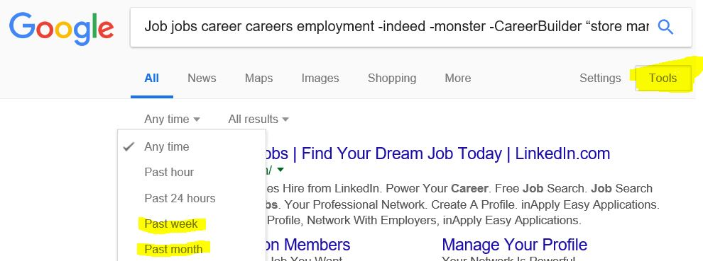
Boolean Search pg. 4

Slide 11
Boolean Search pg. 5
Recap of Boolean. What you have done using this method is now searching company websites and other sources you may have never known about. You eliminated job boards, remember you can search them individually through their job board if you choose. Your Boolean results are the places you more than likely have been missing plus unadvertised jobs that job boards do not have.
Practice and you will have it perfected to your needs. Note tips below:
If you get too many results from one job board go back and – the name in your search bar
Don’t forget to use the tools to get current information by past week or month
Your search string may be 100 or more characters long. Copy and paste each string as you edit to make it easier to put back into the Google search bar. I used a simple word doc to paste these, allowed for easy edits copy and paste saved a lot of time.

Slide 12
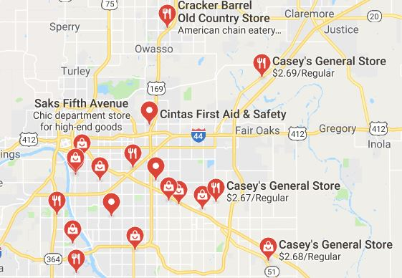
Final Google idea. Use Google maps to find other places you may not have thought of. In this example I went to Google maps typed in (“Store Manager” job ). It now highlights places you can zoom into click the place go to their website, able to apply through the company site. Use this idea with your job title. Practice this and you will perfect your specific need. Sample below:

Slide 13
Boolean & Job Search Wrap-up
Your resume must be clean neat well written with relevance to the need of the employer. Applying through ATS systems is a very weak way to apply, much better to apply directly through the company website. The simple basics of the resume stated above will make your resume rise above others. I have heard 100’s of times (doing those simple things mentioned in the resume part) HR and others say, “this is the best resume I have seen.” Of course, you must be applying for something you qualify for.
Today the Internet has 1000’s of job boards. The one any given employer is using is a gamble despite every one of them full of jobs. Keep this in mind, one job board sends me an offer to post a job for $150.00 each. That is if I purchase 100 at a time, that’s $15,000.00. Then I only have one year to use them all. So, 10 months into this if I haven’t used 50 of the jobs I bought I will post 50 just to collect resumes so my money not go to waste. That’s 50 job postings there is no open position, just looks like it is wasting a job seekers time.
My advice, network let everyone your searching and reach out to new sources. Master your resume then compare to others through Indeed mentioned earlier. Utilize the listen feature through Google mentioned above, how did it sound to you. Finally online, use Google Boolean as your first job search tool, then onto maps followed by job boards.
Confused, have questions, feel free to reach out to me Steve Evans via email, human-resources@usa.net

Slide 14
How this came about.
When doing my own career transition I, like many, was having no solid result. As I pondered why I knew I had to think like the other end, what were they seeing? At that point I contacted all the major job boards to try their ATS software.
Many I had used before in my career but not all. Of course they wanted to sell their services and gave me a trial period offer. This allowed me to experience what it was like to post a job but more importantly was… it allowed me to see what it looked like when I applied through it. An example is… one scores your resume applying a 1-4 rating. Being the best, think HR ever looks at 1 or 2’s. There are so many variables to master if you are going to job search online through ATS that’s another presentation in itself.
I needed open positions though and was not finding them the traditional way through online searching. I developed the Boolean job search strategy and it worked. In fact, well enough Tulsa Community College allowed me to develop and teach a class solely on this process. I no longer teach the class due to schedule conflicts so the class is no longer available.

Slide 15
Final Words
My job search strategy consisted of this….
Network, I realized then I needed more people in my business world
Utilize Eventbrite.com to find networking events and job fairs
Yes, job boards for companies hiring then search company website
Boolean search, spent more time here than job boards
Forget job title search, search for the skills I had, title was irrelevant
Looked at other resumes on Indeed.com got many good ideas from other resumes
Format resume for appearance, ATS friendly and content to match job description
End result…the job I have now does not mirror the job titles of my past. It ended up being the skills I had not past titles. I went from managing a commercial truck repair shop to being a State Instructor today. How, in my career I trained 100’s of people. That skill equated to being able to teach others.
Hope this presentation helps you. Steve Evans

